Slide 1
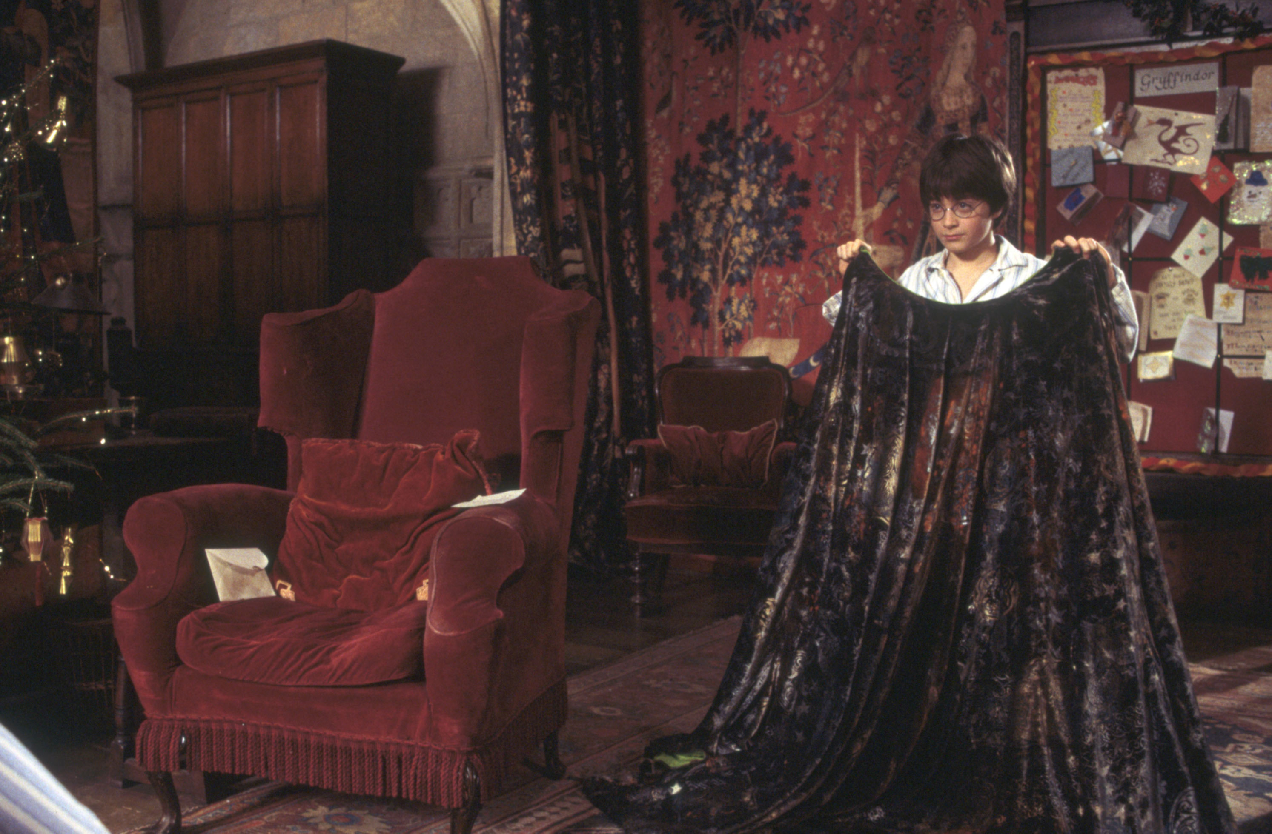
Invisibility Cloak
Group Members:
Christian Casper
Libin Koyikalathu
Brandon Morgan

Slide 2
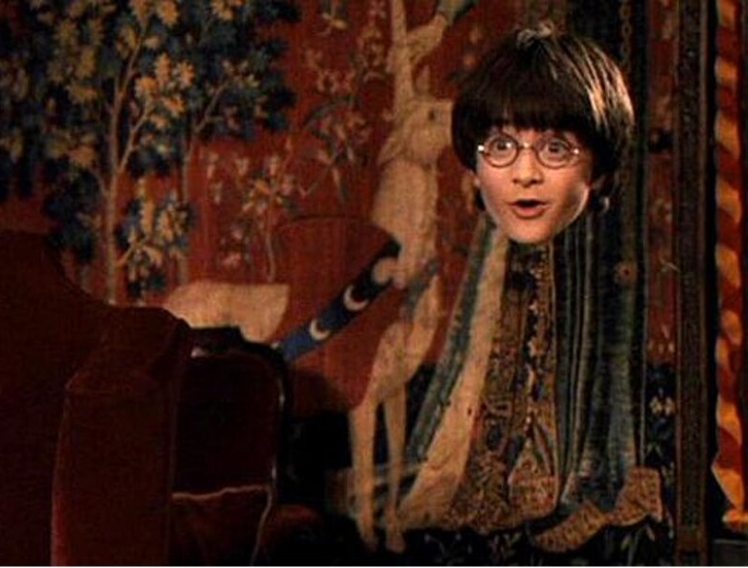
Project Overview
The process of creating an invisibility cloak is much like creating a green screen effect in movie production.
Instead of removing the background like in a traditional green screen, we replace the foreground identified by a specific color.

Slide 3
Assumptions
During the entire process, the camera will remain stationary.
The background needs to correspond with the video feed to give the invisibility effect or the images will not line up correctly.
The cloak will not be present in the background image.
The background will be invisible.
The cloak will be held in the center of the screen.
If the cloak is not centered correctly , then the algorithm will not read in the desired RGB values from the patch.

Slide 4
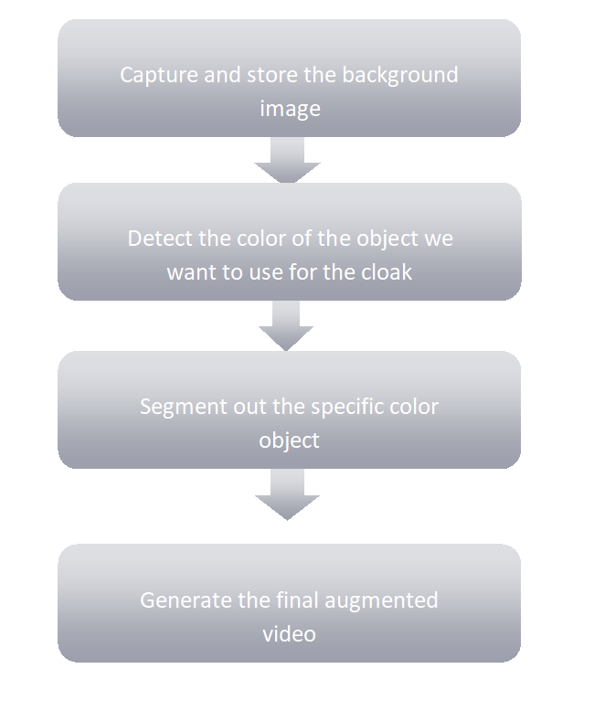
Process Overview

Slide 5
Project Demonstration
Let the magic begin!!!

Slide 6
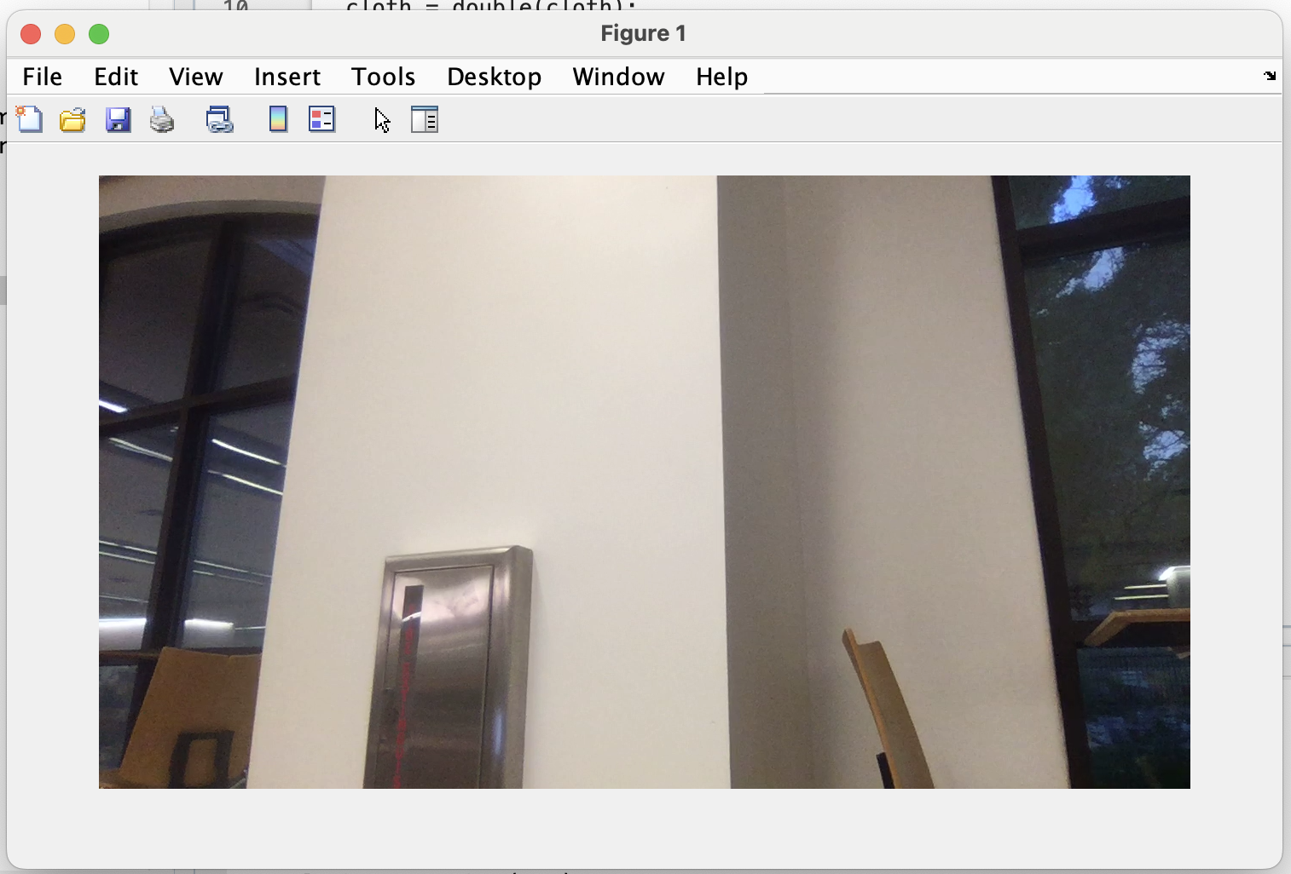
Capture and Store the Background Image
The idea of invisibility is to blend in with your surroundings.
To achieve this, you need to know what is in the background.
We will replace the cloak pixels in the output video with the background pixels corresponding to the cloak location.

Slide 7
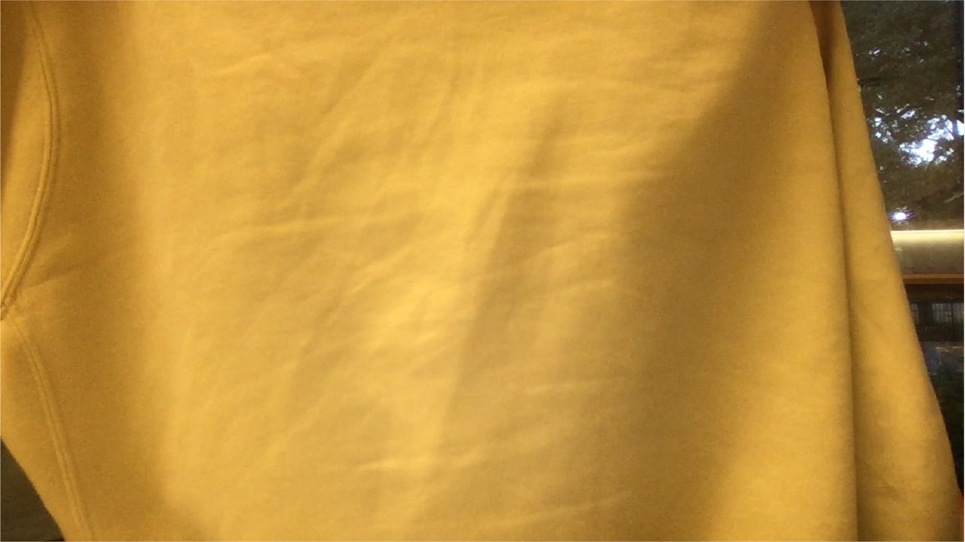
Detecting the Color of the Cloak
Color detection is used to determine which part of the video will need to be replaced.
Take an RGB image of the cloak in the foreground.
Crop the center area of the image.
Find the mean of red and green values, and then take the standard deviation of red and green values.

Slide 8
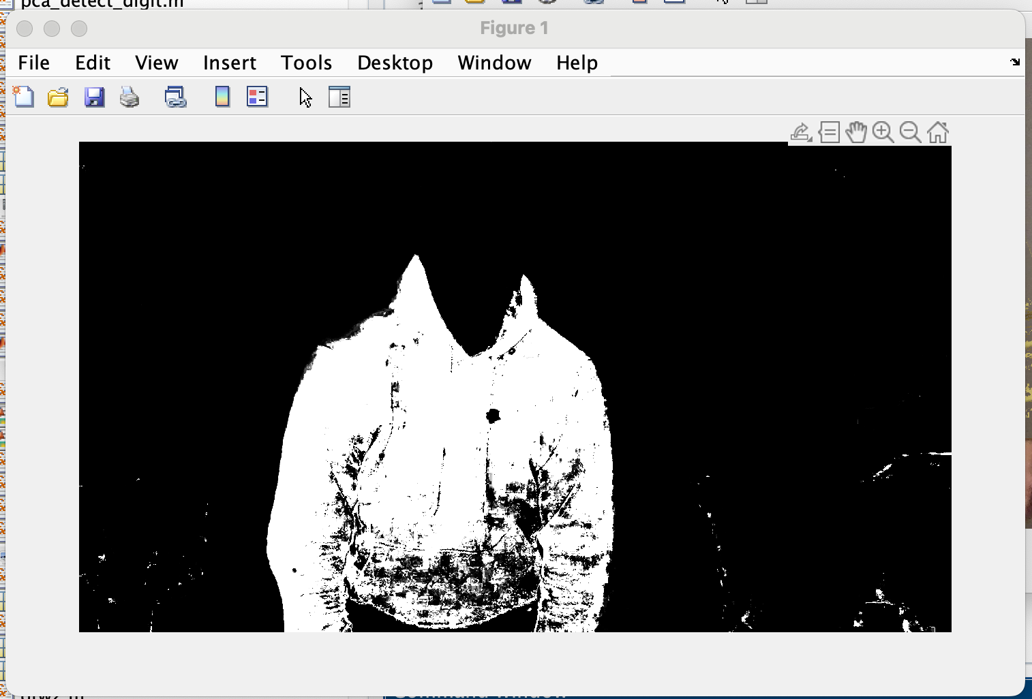
Segmentation
To isolate the cloak on every frame, we take the highest probabilities of each pixel.
Skin Detection Algorithm
Get the average green and red on every pixel
Gaussian Probability
Binarize values that high probability

Slide 9
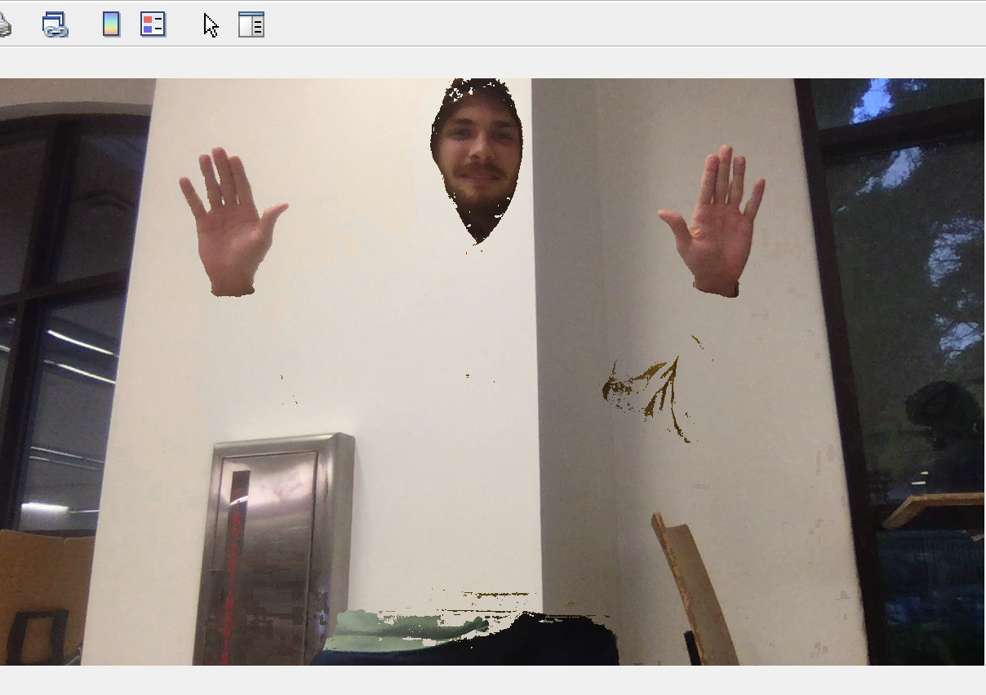
Generate the Final Augmented Video
The background image, probability image, and the live video feed will be augmented together to create the invisible effect.
We iterate through the probability image and look at each pixel.
Values that equal one identify the location of the pixel(i,j)
Replaced the video pixel(i,j) with the background image pixel(i,j).

Slide 10
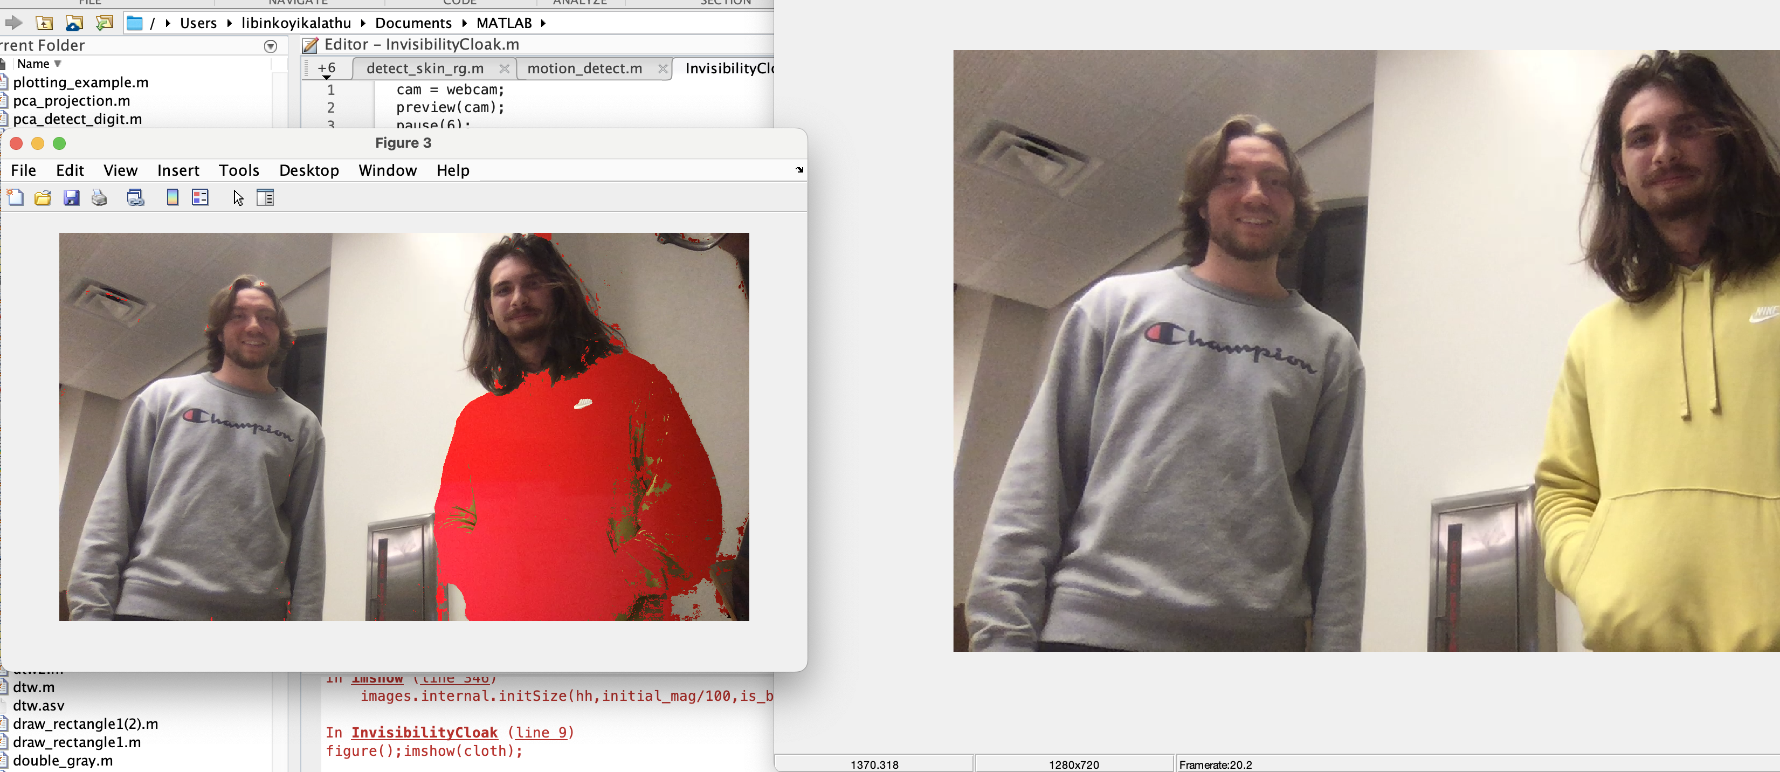
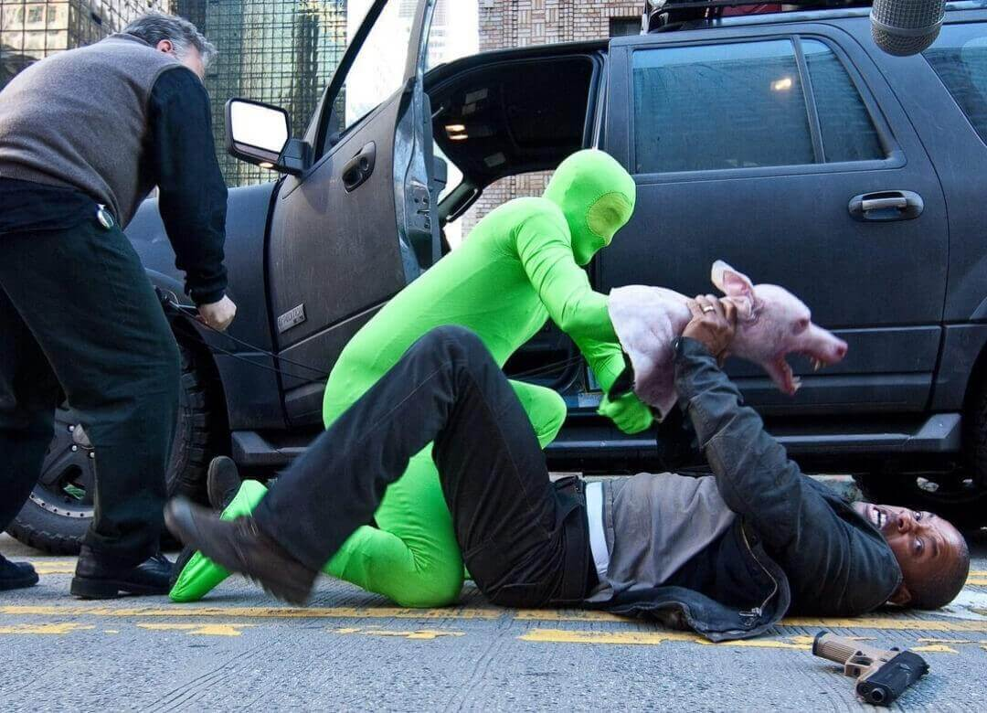
Project Application
This can be used to clean up unwanted objects in an image.
It could also be used to add visual effects into videos.
You can try on any clothes from the internet.

Slide 11
Conclusion
Computer Vision can be used to solve intriguing problems involving image processing and manipulation.
In this project we were able to implement color segmentation to create a green screen effect using a specific color range in a video.
We successfully implemented a skin detection algorithm that computed the probability that an individual pixel in a video matches the color of the cloak.
This project shows some of the many things people can do with Computer Vision.

